Slide 1
User Input

Slide 2
User Input
That means we are able to ask the user for input.
Syntax in Java:----
import java.util.Scanner;
Create a Scanner object to read input Scanner
Read a line of text from the user String
a Scanner object, use scanner.nextLine() to read a line of text from the user, and then display the input.
Syntax in Python:---
# Get user input
user_input = input("Enter something: ")
Syntax in C++:---
can use the cin
Declare a variable to store user input
Read a line of text from the user
getline(cin, userInput)

Slide 3
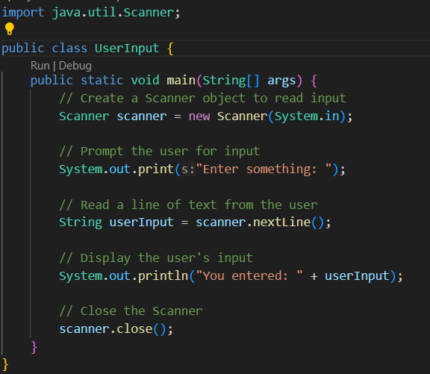
Java:-

Slide 4
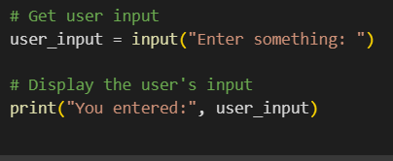
Python:-

Slide 5
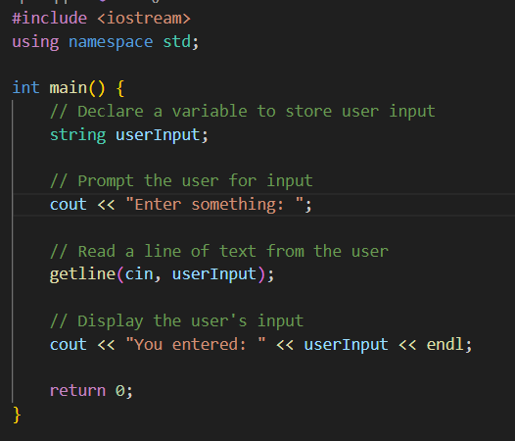
C++:-

Slide 6
How to use different data types???
Java:-
String userInput = scanner.nextLine();
int number = scanner.nextInt();
float floatValue = scanner.nextFloat();
double doubleValue = scanner.nextDouble();
Python:-
input()
int(input())
float(input())

Slide 7
C++:-
string userInput; and getline(cin, userInput);
int number; and cin >> number;
float floatValue; and cin >> floatValue;
double doubleValue; and cin >> doubleValue;

Slide 8
Task:-----
Type your name is Ali, Salary is 25000 and Age is 22.5 using user input function.
Get user input for the length and width of the rectangle. And calculate the area of the rectangle using the provided inputs.
Write a program user input function get Your Name, Email Address and Contact Number.
Applying +,-,* and / using user input.
Write one day leave application using user input methon. Note:- \n for next line and \t for tab space.
Converting Celsius to Fahrenheit temperature. Note: fahrenheit = (celsius * 9/5) + 32
Converting Fahrenheit to Celsius temperature.

